Slide 1
HNDIT1106 – Web Development
Chapter 11: Protecting data in the internet

Slide 2
Objectives
Explain the different types of computer crime and the difficulties of discovery and prosecution.
Describe the aspects of securing corporate data.
Explain the threats to personal privacy posed by computers and the Internet.
Describe actions you can take to maximize your privacy.

Slide 3
Introduction
Computer virus have become today’s headline news
With the increasing use of the Internet, it has become easier for virus to spread
Virus show us loopholes in software
Most virus are targeted at the MS Windows OS

Slide 4
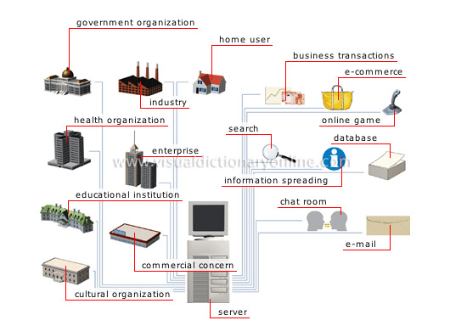
Internet Use for

Slide 5
Security Basics
What does it mean to be secure?
“Include protection of information from theft or corruption, or the preservation of availability, as defined in the security policy.” - The Wikipedia
Types of Security
Network Security
System and software security
Physical Security
Very little in computing is inherently secure, you must protect yourself!
Software cannot protect software (maybe hardware can)
Networks can be protected better than software

Slide 6
Goals of Computer Security
Integrity:
Guarantee that the data is what we expect
Confidentiality
The information must just be accessible to the authorized people
Reliability
Computers should work without having unexpected problems
Authentication
Guarantee that only authorized persons can access to the resources
Notes:
CS = Computer Security

Slide 7
Privacy
The ability of an individual or group to seclude themselves or information about themselves and thereby reveal themselves by selectively.
Authentication
The act of establishing or conforming something(or someone) as authentic, that is, that claims made by or about the thing are true.

Slide 8
Who is vulnerable?
Financial institutions and banks
Internet service providers
Pharmaceutical companies
Government and defense agencies
Contractors to various government agencies
Multinational corporations
ANYONE ON THE NETWORK

Slide 9
Enemies
Hackers
Access systems in an unauthorized manner.
Hackers have no malicious intent
(i.e., they do not intend to cause harm).
They are only motivated by curiosity, personal satisfaction, or gaining reputation etc.
Crackers
Individuals who cause damages to information systems with a malicious intent often for financial gains.

Slide 10
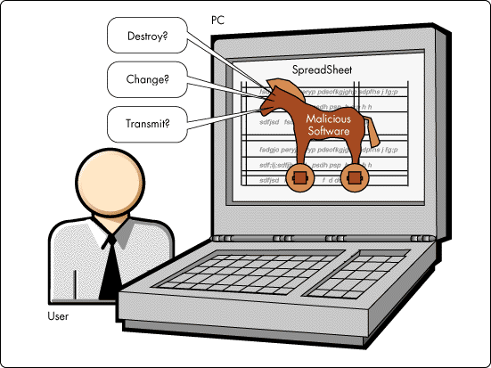

Malicious Software
Malicious software, commonly known as malware, is any software that brings harm to a computer system. Malware can be in the form of worms, viruses, trojans, spyware, adware and rootkits, etc., which steal protected data, delete documents or add software not approved by a user.

Slide 11
Types of Vulnerabilities
Virus
A malicious code that infects software on a computer, thereby causing undesired results, such as changing system settings, deleting files, disabling functions, and some even hardware damage (flashing the CMOS).
A virus spread by making copies of itself and spreading.
It may spread between files or disks, but the defining character is that it can recreate itself on it’s own without traveling to a new host.
First virus was created to show loopholes in software

Slide 12
Symptoms of Virus Attack
Computer runs slower than usual
Computer no longer boots up
Screen sometimes flicker
PC speaker beeps periodically
System crashes for no reason
Files/directories sometimes disappear
Denial of Service (DoS)
You can protect your machine by using an updated anti-virus software.

Slide 13
Virus through the Internet
Today almost 87% of all viruses are spread through the internet (source: ZDNet)
Transmission time to a new host is relatively low, on the order of hours to days

Slide 14
Types of Vulnerabilities…(cont.)
Worms
Has similar properties to a virus
Spread over network connection
Worms replicate
Has the capability of moving from location to location(PC to PC) thereby doing some damage and going somewhere else.
Can spread and cause damage on its own without attaching to another program
Even if you scan your machine, the worm will not be found
First worm released on the Internet was called Morris worm, it was released on Nov 2, 1988.
Recent e.g. CodeRed, BugBear, SoBig etc.

Slide 15
Macro
Specific to certain applications
Comprise a high percentage of the viruses
Usually made in WordBasic and Visual Basic for Applications (VBA)

Slide 16
Types of Vulnerabilities…(cont.)
Trojans
A class of software that enters into your system pretending to be something else, or a part of another software.
Hidden
Leaks information
Usually does not reproduce
Keyloggers, adware, spyware, could all enter into your system as trojans.

Slide 17
Types of Vulnerabilities…(cont.)
Spyware
This is a class of applications that spy on the users activities.
They may provide others access to your system, display unwanted banner ads, or steal your confidential information

Slide 18
Symptoms
Targeted Pop-ups
Slow Connection
Targeted E-Mail (Spam)
Unauthorized Access
Spam Relaying
System Crash
Program Customisation
SPYWARE
SPYWARE / TROJAN
SPYWARE
TROJAN HORSE
TROJAN HORSE
SPYWARE /TROJAN
SPYWARE

Slide 19
Effects
Allows remote access
To spy
To disrupt
To relay a malicious connection, so as to disguise the attacker’s location (spam, hacking)
To access resources (i.e. bandwidth, files)
To launch a DoS attack

Slide 20
Operation
Listen for connections
Memory resident
Start at boot-up
Disguise presence
Rootkits integrate with kernel
Password Protected

Slide 21
Similarities / Differences
Spyware | Trojan Horses
Commercially Motivated | Malicious
Internet connection required | Any network connection required
Initiates remote connection | Receives incoming connection
Purpose: To monitor activity | Purpose: To control activity
Collects data and displays pop-ups | Unauthorized access and control
Legal | Illegal
Not Detectable with Virus Checker | Detectable with Virus Checker
Age: Relatively New (< 5 Years) | Age: Relatively Old ( > 20 Years)
Memory Resident Processes
Surreptitiously installed without user’s consent or understanding
Creates a security vulnerability

Slide 22
Types of Vulnerabilities…(cont.)
Spam
Spam is “unsolicited” email – email that is sent without permission.
This normally consists of credit cards, stock reports, etc.
Replying to a spammer and asking him not to sent emails is pointless.
Best thing to do is to use a spam filter , which filter out the spam mail and send it to another folder, or delete it.
Adware
This is software that courses various advertisements to display on your system as pop-ups or pop-unders while you are browsing on-line.
Keyloggers
This is software/hardware that monitors your keystrokes and records them/publishes them.
This attempt to capture passwords, credit card numbers, and other sensitive information.

Slide 23
Web Attacks
Phishing
An evil website pretends to be a trusted website
Example:
You type, by mistake, “mibank.com” instead of “mybank.com”
mibank.com designs the site to look like mybank.com so the user types in their info as usual
BAD! Now an evil person has your info!
SQL Injection
Interesting Video showing an example
Cross Site Scripting
Writing a complex Javascript program that steals data left by other sites that you have visited in same browsing session
Need to know:
Web Programming,
Javascript, SQL

Slide 24

Junk e-mail
Cheaper than snail mail
Spamming
Sends e-mail messages to “everyone”
Abandons the originating site
Help eliminate junk e-mail
Do not complete a member profile with online service
Do not fill in registration forms unless the purveyor promises not to sell or exchange your information
Never respond to spamming
Use filter software

Slide 25
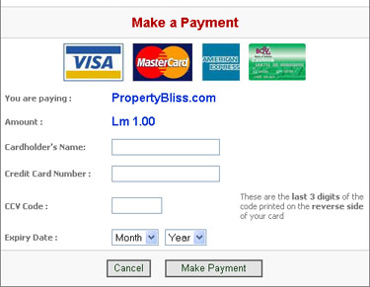
Identity Theft
In the Internet sometimes you have to disclose your personal information such as name, telephone numbers and email addresses
To make online purchases you need to give your credit
card number
However, you got to be careful when you disclose your personal information over the Internet

Slide 26

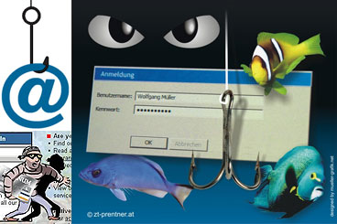
Identity Theft (cont.)
Identity theft is the act of using someone’s Identity and good reputation by another individual for financial gains
One of the fastest growing crimes in United States
A popular way to obtain private information is by using phishing scams
In phishing scams attacker sends an
email to the victim which looks like
a legitimate request for victims
personal information

Slide 27
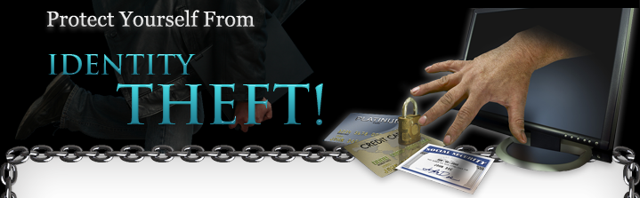
Preventing Identity Theft
Do not disclose your private information over emails
Always check whether a website is a trusted one before you enter any sensitive information
Always check whether the website supports secure transactions (others cannot see the information you send to secure sites)
Always read privacy policies given on websites

Slide 28
Network and Web Site Security
Tools such as passwords, firewalls, intrusion detection systems, and virus scanning software should be used to protect a network and Web site.

Slide 29





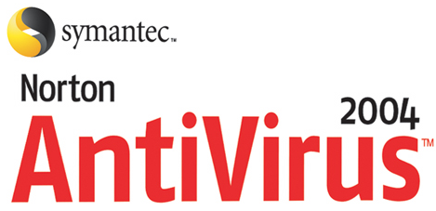
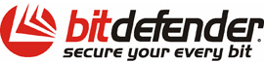
Preventing Malicious Software
Always use a virus scanner and keep it up to date with latest updates
Enable auto-protect features of your virus scanner
Use a spyware scanner to scan and remove spyware and update it regularly
Never download content from unknown web sites
Never open email attachments coming from unknown sources
sources

Slide 30
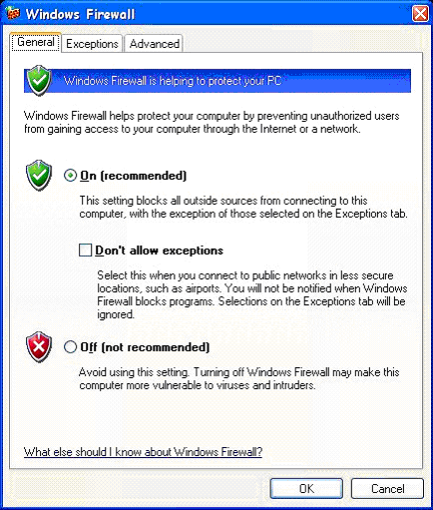
Preventing Malicious Software (cont.)
Use a personal firewall
Keep your operating system
updated with latest updates
and patches
Never click “yes” in unknown
popup ads that appear.
Always close them using “x”
on the upper right hand corner

Slide 31
Attacks on Passwords
Brute force attack
Here the attacker tries all possible combinations for a password until he gets the correct one
There are programs written to do this task
Dictionary attack
The attacker tries all the words in a dictionary with the hope of discovering the password (including names, places, etc.)
There are dictionaries of frequently used passwords that can be used for this purpose

Slide 32
Attacks on Passwords…(cont.)
Keystroke Monitoring
Attacker tries to obtain a password by looking at your key strokes while you enter your password
Dumpster diving
Attacker searches through trash bins with the hope of finding written down passwords or other confidential information

Slide 33
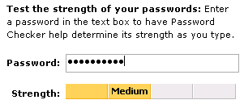
Strong Passwords
Passwords are not stored in clear-text (i.e., readable) format in your computer
It is possible for someone to find out your password either by guessing it or by carrying out a password attack.
Cannot be easily guessed by others or cracked by password cracking programs
Strong passwords are essential to protect your information
For example, “sdfo839f” is a good password

Slide 34
Password Best Practices
Always use a password of a minimum of eight characters
Do not use your name, birthday, name of a close relative as your password since these can be easily guessed
Use non-dictionary words for your password
Always use a combination of uppercase/lowercase characters, numbers.
Use at least one special character in your password
(e.g., !,#,$,@)
Change your password at least twice every month
Never write down your password in books, pieces of paper, diary etc.
Never send your password via email or disclose it to someone even if you trust that person

Slide 35
Cookies
Privacy Monitoring by Web Sites
A Cookie is a small text file sent to the user from a website.
Contains Website visited
Provides client-side personalisation
Supports easy Login
Cookies are controlled by…
Website’s Application Server
Client-side Java Script
The website is effectively able to ‘remember’ the user and their activity on previous visits.

Slide 36
Cookie
Stores information about you
Located on your hard drive
Beneficial uses
Viewing preferences
Online shopping
Secure sites retain password in cookie
Controversial use
Tracking surfing habits for advertisers
Can set browser to refuse cookies or warn before storing
Software available to manage cookies

Slide 37
Web Proofing
The process of tracking the behavior of users including
the sites they go to
How much time they spend there
What they do there etc.

Slide 38
Protection/Prevention
Knowledge
Proper configurations
Run only necessary programs
Anti-virus software

Slide 39


Identifying Secure Websites
Secure websites have a URL starting with https://
There is a closed padlock icon at the bottom of the browser status bar

Slide 40
Solutions
Short Term
Long Term
Add Spyware to Anti-Virus
Automatic maintenance
Legislation
Education on problems
Biometric access
Semantic web (and search)
Firewall
Virus Checker
Spyware Remover
Frequent OS updates
Frequent back-up
Learning problems

Slide 41
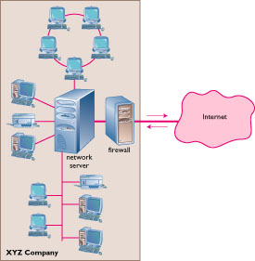
Internet Security
Firewall
Dedicated computer that governs interaction between internal network and the Internet
Encryption
Data Encryption Standard (DES)

Slide 42



Internet Security
Purpose of Security
Keeping anyone from doing things you do not want them to do to, with, on, or from your computers or an peripheral devices
Protecting corporate network from illegal Internet access
Strategies for a secure Network
Strategy: building firewall
MacAfee
Norton

Slide 43
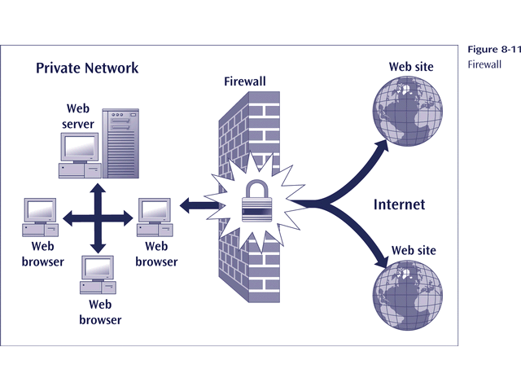
Firewall

Slide 44
What is a Firewall?
A firewall is hardware, software, or a combination of both that is used to prevent unauthorized programs or Internet users from accessing a private network and/or a single computer
filter
filter
gateways
Inside
Outside

Slide 45
What is a Firewall?...(cont.)
A firewall is software or hardware that checks information coming from the Internet or a network, and then either blocks it or allows it to pass through to your computer, depending on your firewall settings.
A firewall can help prevent hackers or malicious software (such as worms) from gaining access to your computer through a network or the Internet. A firewall can also help stop your computer from sending malicious software to other computers.
A firewall isn't the same thing as an antivirus program. To help protect your computer, you need both a firewall and an antivirus and anti-malware program.

Slide 46
Hardware vs. Software Firewalls
Hardware Firewalls
Protect an entire network
Implemented on the router level
Usually more expensive, harder to configure
Software Firewalls
Protect a single computer
Usually less expensive, easier to configure

Slide 47
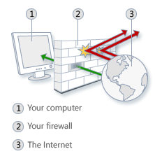
How does a software firewall work?
Inspects each individual “packet” of data as it arrives at either side of the firewall
Inbound to or outbound from your computer
Determines whether it should be allowed to pass through or if it should be blocked

Slide 48
Firewall Rules
Allow – traffic that flows automatically because it has been deemed as “safe” (Ex. Meeting Maker, Eudora, etc.)
Block – traffic that is blocked because it has been deemed dangerous to your computer
Ask – asks the user whether or not the traffic is allowed to pass through

Slide 49
What a personal firewall can do
Stop hackers from accessing your computer
Protects your personal information
Blocks “pop up” ads and certain cookies
Determines which programs can access the Internet
Role
A firewall shields the Internal corporate network from the Internet
The Internal network works normally

Slide 50
What a personal firewall cannot do
Cannot prevent e-mail viruses
Only an antivirus product with updated definitions can prevent e-mail viruses
After setting it initially, you can forget about it
The firewall will require periodic updates to the rule sets and the software itself
Examples of personal firewall software
ZoneAlarm <www.zonelabs.com>
BlackICE Defender <http://blackice.iss.net>
Tiny Personal Firewall <www.tinysoftware.com>
Norton Personal Firewall <www.symantec.com>

Slide 51
How Firewall Works
Proxy Server (an example)
step 1: A request from a corporate network
step 2: That request being Sent to proxy server
step 3: A proxy server sends the request to the targeted Internet server
step 4: The internet server fulfilled the request and sends the answer back to proxy server
step 5: The proxy server sends the answer back to the corporate network
Corporate
Computer
Internet
Proxy
Server

Slide 52
Building Firewall
Positioning Firewalls
Net 2
Net 1
Net 3
Internet
Net 4
Net 6
Net 5

Slide 53
Limitations of Firewall
No protection against problems with higher level protocols
The degree of protection against threads depends on how carefully the gateway code is written
Any information that passes inside can trigger problems
At best, a firewall provides only a convenient single place to apply a corrective filter.

Slide 54
Cryptography
Simply – secret codes
Encryption
Converting data to unreadable codes to prevent anyone form accessing this information
Need a “key” to find the original data – keys take a few million-trillion years to guess
Public keys
An ingenious system of proving you know your password without disclosing your password. Also used for digital signatures
Used heavily in SSL connections
Hashing
Creating fingerprints of documents
Need to know:
Mathematics, number theory, cryptographic protocols

Slide 55
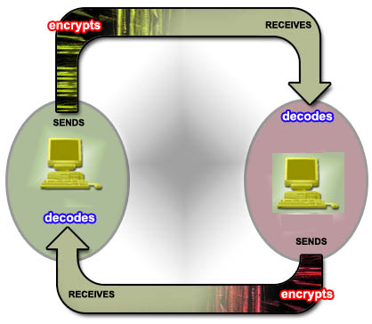
Encryption
Encryption makes your data unreadable to others
Encryption takes your normal messages (called clear text) and changes it to an unreadable format called cipher text
Example:
Take the word “Hello” and replace each letter by three letters ahead in the alphabet. You end up with “Khoor” which is unreadable

Slide 56
Cryptography
Cryptography
The field of study related to encoded information (comes from Greek word for "secret writing")
Encryption
The process of converting plaintext into ciphertext
Decryption
The process of converting ciphertext into plaintext
Encryption
plaintext
message
ciphertext
message
Decryption
Encrypted(Information) cannot be read
Decrypted(Encrypted(Information)) can be

Slide 57

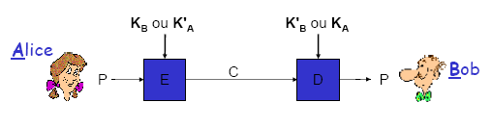
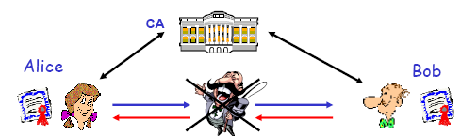
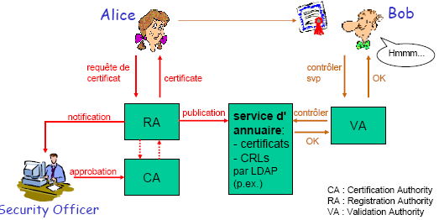
Cryptographic Protocols
Asymmetric encryption
Symmetric encryption
Public Key Infrastructure
Authentication

Slide 58
How can you achieve security?
Many techniques exist for ensuring computer and network security
Cryptography
Secure networks
Antivirus software
Firewalls
In addition, users have to practice “safe computing”
Not downloading from unsafe websites
Not opening attachments
Not trusting what you see on websites
Avoiding Scams

Slide 59
Transaction Security and Data Protection
Use a predefined key to encrypt and decrypt the data during transmission.
Use the secure sockets layer (SSL) protocol to protect data transmitted over the Internet.
Move sensitive customer information such as credit card numbers offline or encrypting the information if it is to be stored online.

Slide 60
Transaction Security and Data Protection - internal
Remove all files and data from storage devices including disk drives and tapes before getting rid of the devices.
Shred all hard-copy documents containing sensitive information before trashing them.
Security is only as strong as the weakest link.

Slide 61
Chapter Review
What is Computer Security?
What is Network Security?
What is Internet Security?
What are the technologies design to protect network connections and data transfer over the internet?
When we doing instant chatting (Skype, gtalk, etc.) viruses can attack our machine. How could that happen and how can we avoid it?
What does antivirus software do?
Briefly explain term Data Encryption with its process.
How can you protect your privacy on the Internet? Briefly explain.

